Slide 1

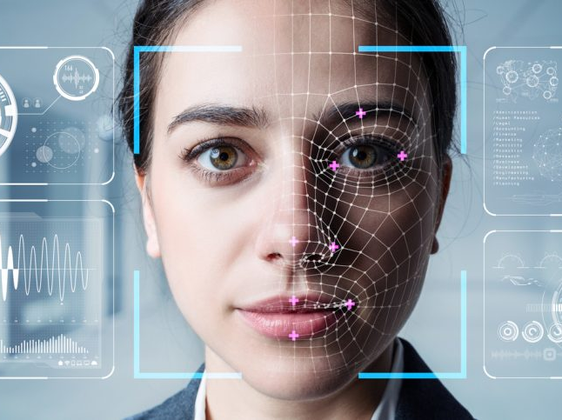
Facial Recognition (Initial Project)
Aran Miller
Comp 4449 – Data Science Capstone
2 June 2021

Slide 2

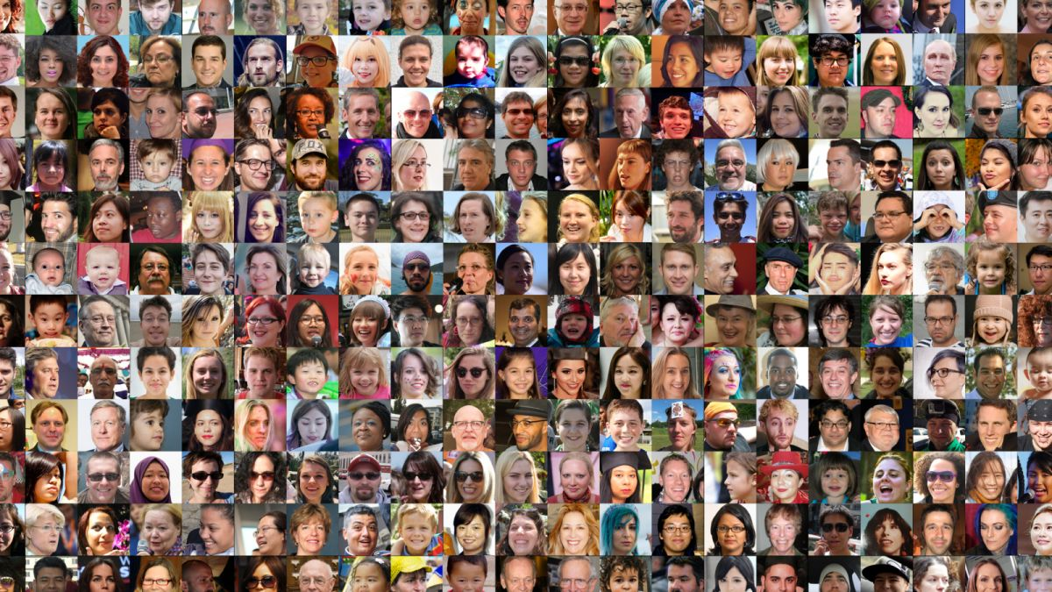
Proposal
Research Question:
Can we teach a computer to accurately identify individuals in photos and videos?
Facial recognition, from science fiction to an entire industry
Building a model and program that can accurately identify individuals has countless applications
Goal of this project is to build a fully functioning facial recognition program with unique dataset to further understanding of facial recognition

Slide 3
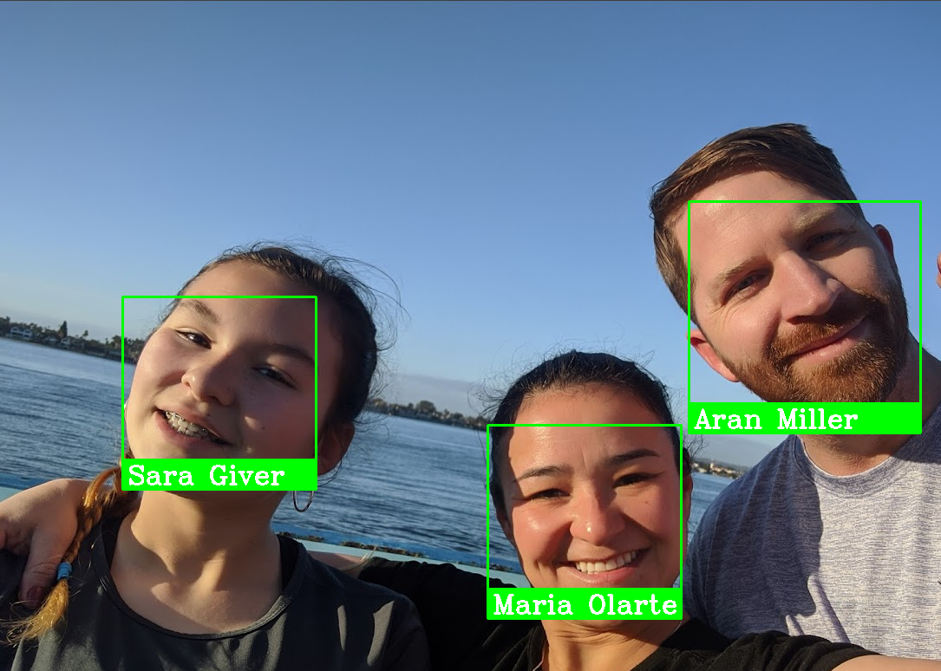
Dataset Description
Data consist of 554 images
Each image was classified into 11 categories
10 known individuals
1 unknown category
98 images used for training
456 images used for testing

Slide 4
Steps of Facial Recognition
Find the face in an image/video
Generate landmarks for facial features
Use landmarks to make facial features standardized
Determine which features to compare images between
Compare two faces to determine likelihood of a match

Slide 5
Models Used
Caffe model (Face Detection)
Haar Cascades model (Face Detection)
Histogram of Oriented Gradients model (Face Detection)
Convolutional Neural Network model (Face Detection and Face Identification)
Linear Support-Vector Machine model (Classification)

Slide 6
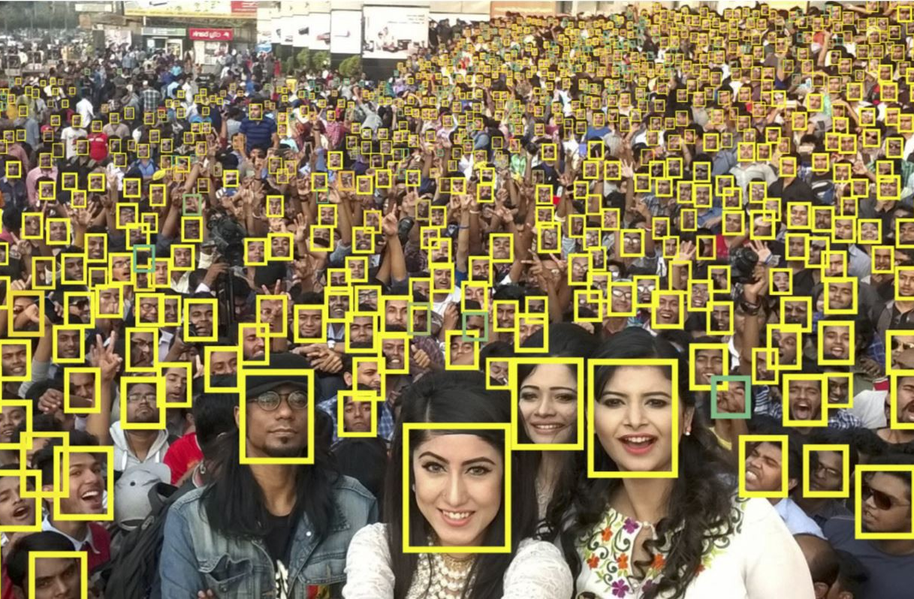
Face Detection Overview
Models: Caffe, Haar Cascade, Histogram of Oriented Gradients, Convolutional Neural Network
Detecting the face in an image is the most taxing and most “manual” part of facial recognition

Slide 7
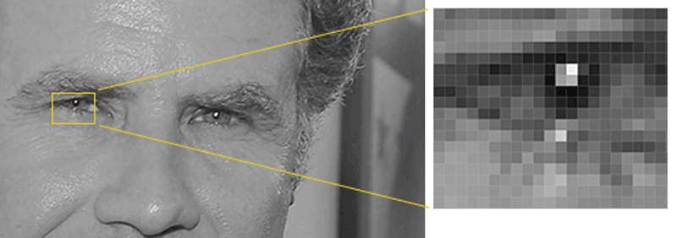
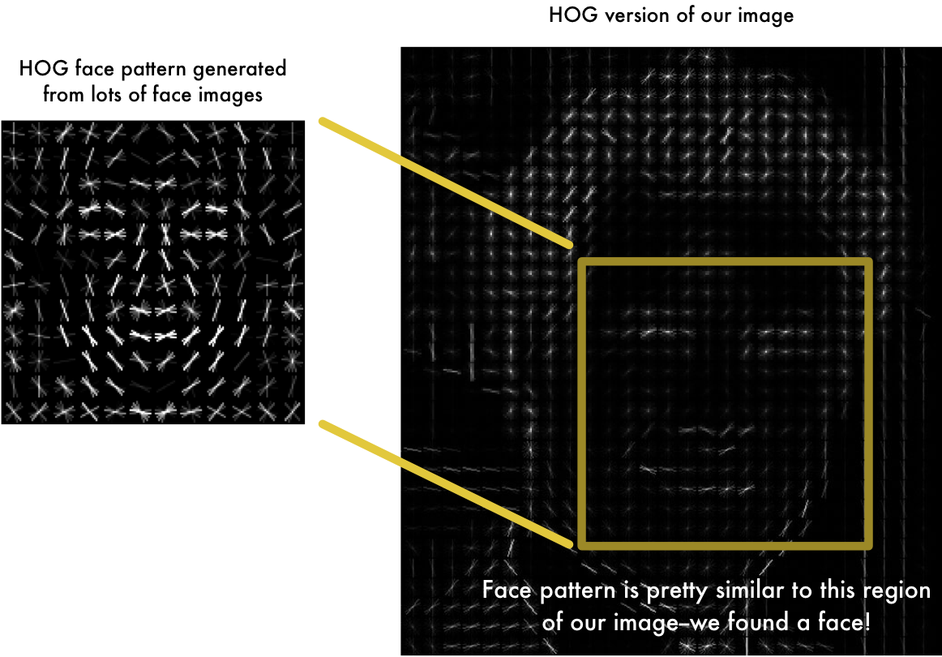
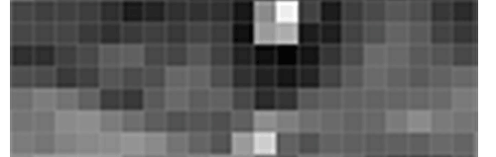
Face Detection Hog method
The Histogram of Oriented Gradients model is the class leader for face detection
CNN face detection could become more reliable/accurate soon

Slide 8
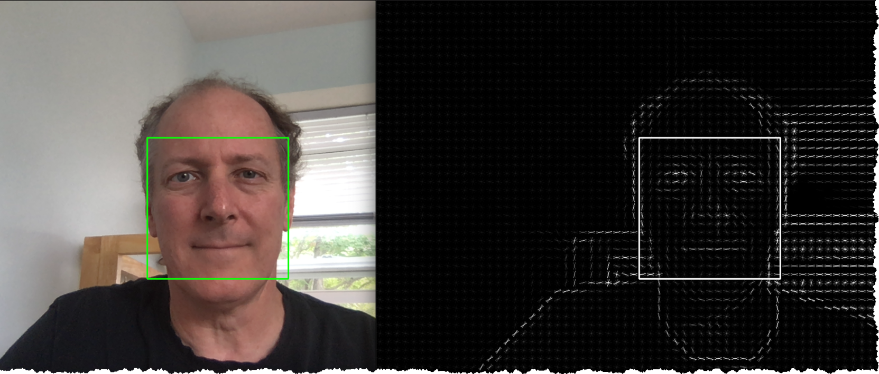
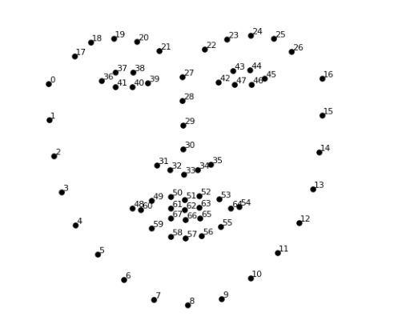
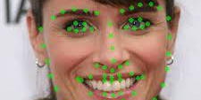
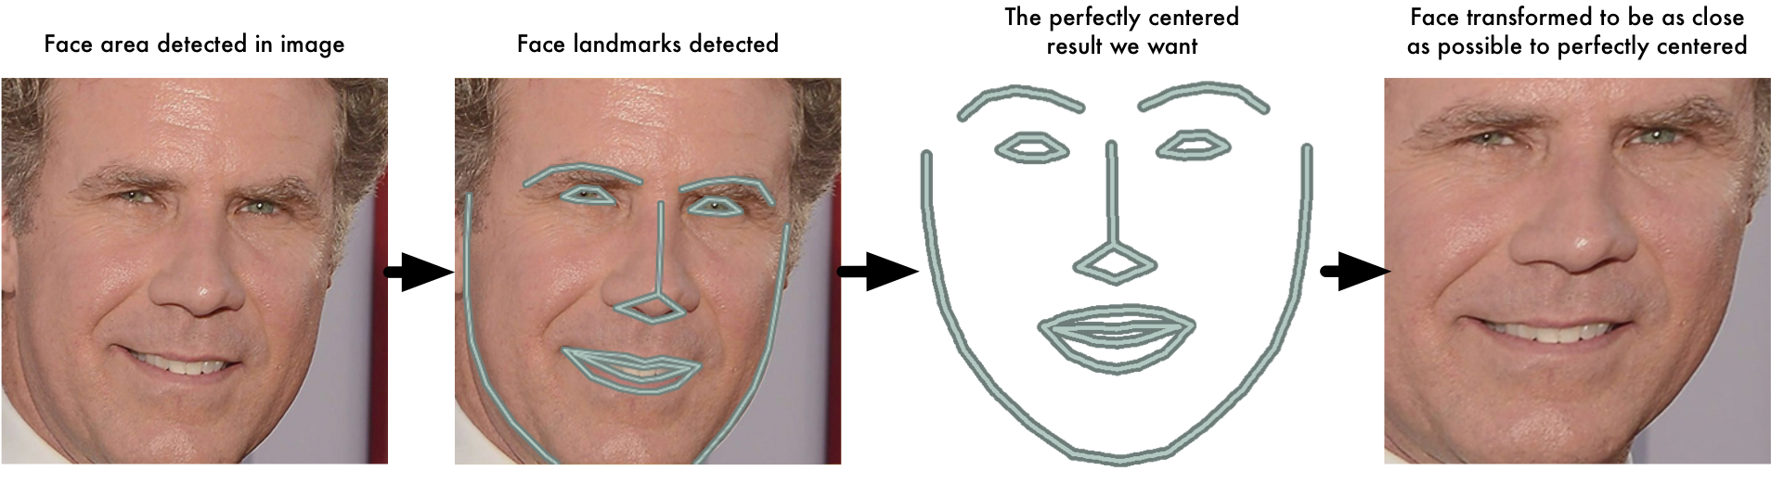
Face Detection Hog method
Determine landmarks (68 landmarks is standard) for facial features
Use 68 landmarks to warp image to ideal locations

Slide 9



Face Encoding
Convolutional Neural Networks
Triplet Loss
Use 3 images, 2 of the same person and 1 of a different person (Anchor, Positive, Negative)
Images are transformed into vectors of 128 numbers
Gradient decent performed to minimize loss function
L(a, p n) = max( D(a,p) – D(a,n) + alpha, 0)
D(x,y) is the distance between the generated vectors

Slide 10
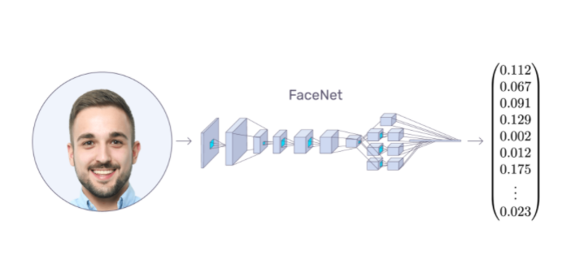
Face Encoding
Millions of photos of tens of thousands of people generate reliable vectors
The vectors and numbers within them are meaningless to humans, not based on eyes, nose, ears, mouth
These 128 point vectors create an “identity” for each person

Slide 11
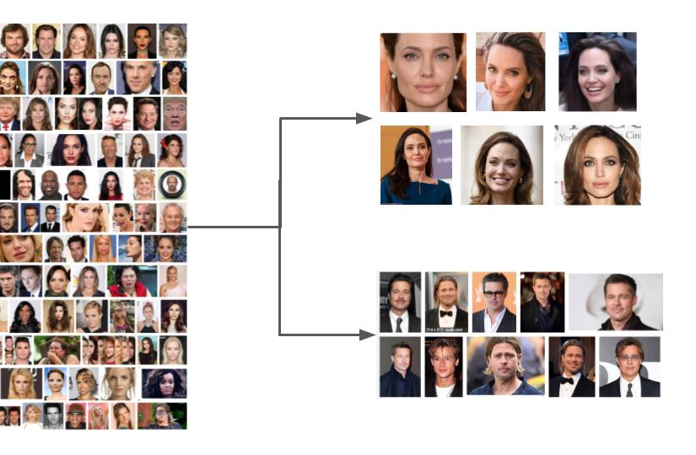
Identify unknown face
The Classification section of facial recognition is almost trivial compared to the rest of the system
Train the classifier on the known labeled persons, then predict the label for the unknown persons
Classify unknown faces against known faces, - Linear SVM Classifier, KNN Classification

Slide 12
Results
Both SVM and KNN models were checked for accuracy (correctly identifying known and unknown persons
Both used the optimal threshold
SVM achieved 98.995% accuracy
KNN achieved 98.995% accuracy

Slide 13
Conclusion
Facial Recognition and computer vision is a rapidly expanding field.
Facial Recognition has is able to accurately predict unknown persons because of Neural Networks
Next Steps:
Build a fully functioning Facial Recognition platform from the ground up.
Create a dataset of images with 10s of millions of images
Generate and train face detection and face identification models
1 to Many matches

